Slide 1
Surviving “The Perfect Storm”
How Business Architecture played a pivotal role
Presented by Tony Woods and Pat Salaski
Twin Cities Business Architecture Forum
Hosted by Express Scripts
18 March 2014

Slide 2
Let’s begin at the end of the story . . .

Slide 3

January 1, 2014
The most significant
1/1 in the company’s history!
Notes:
Every company has that date or season that is pivotal for them. For retail companies, for example, it’s Black Friday and the holiday shopping season. For us, it’s January 1st, when the majority of our projects are implemented to align with the myriad of laws and mandates that go into effect on that date.
1/1 is always a really big deal at ESI, but January 1st 2014 was even more significant . . .
New clients, expansion of current business with existing clients, new mandates, HCR went live, migration of the Medicare business to the new platform.
One-third of all prescriptions in the United States are processed by Express Scripts, so it was crucial that this go off without a hitch. As of 1/1/14, they are all processed on a single platform.

Slide 4

Notes:
It could have sunk us . . . but it didn’t.
Thanks to processes and procedures we put in place over the past year and the support we provided to the people who performed those processes, we were ready for the storm so our story had a happy ending.
Things could have turned out differently, though.
Let’s take a step back in time to about this time last year and look at what we did that prevented us from falling victim to the Perfect Storm.

Slide 5
In the beginning . . .

Slide 6

February 2013 | Government Programs Integration Gaps
Notes:
The ripple effect is so much greater than the original impact formed by the single stone.
How many of you were here @ our TCBAF meeting last March?
You might remember that we talked then about the role that Business Architecture played in helping build alignment between our business teams and IT teams regarding the gaps that existed in how our two companies.

Slide 7
The Merger – Key Facts
In April 2012, Express Scripts completed a $29.1 billion acquisition of Medco Health Solutions.
The acquisition positioned Express Scripts Holding Co. as the largest pharmacy benefit manager, filling 1.4 billion annual prescriptions.
2012 revenues of $93.8 billion.
1/3 of all prescriptions in US
are processed by Express Scripts
Notes:
Once the merger was approved --- We started moving clients to a single platform
2013 started with moving some of our most complex, highly regulated business over …
While both companies were in the same industry --- we did not always offer the same services to our clients and needed to come together with a common approach. This started with identifying gaps in the system of choice.

Slide 8
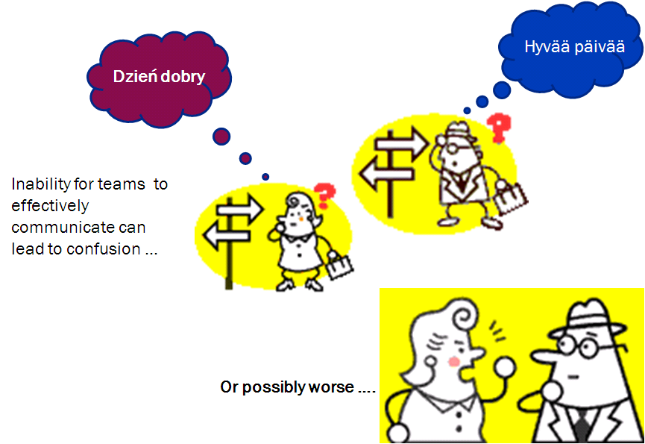
February 2013: Gap Identification
The Challenge
Identify gaps between legacy and new systems
Gain alignment between teams from both companies
Come together quickly to meet client and market expectations
Our Response
Leveraged the Business Capability map as a tool to create common language, drive conversations and build business alignment
Business Outcomes – teams came together and were able to effectively communicate and understand each other and make critical decisions more quickly.

Slide 9
March 2013 | Integration Project Kick-Offs
Notes:
The ripple effect is so much greater than the original impact formed by the single stone.

Slide 10


March 2013: Integration Project Kick-Offs
Much larger group of people
Both companies had completely different Project Lifecycle processes
Projects followed “business as usual” business requirements process from one of the combined companies
Confusion and lack of common language started all over again
Did not take advantage of alignment gained in February
The Challenge
Our Response
New Project Approach: Business Capability Centric Requirements
Project Requirements Sessions
Business Capability Impact Assessments
Business Outcomes – Common language was spreading across the company to more people. Building momentum Project Lifecycle approach was recognized by the business as a success.
Notes:
By introducing a new approach that we called business capability centric requirements we were able to (add benefits here)

Slide 11

April 2013 New Government Mandates
Notes:
The ripple effect is so much greater than the original impact formed by the single stone.
About the time we were starting to build momentum with the integration efforts, the federal government announced its new mandates for 2014.
More mandates than in past years and more complex mandates --

Slide 12
April 2013: New Government Program Mandates
Largest, most complex set of government mandates issued
Integration projects were still going on
Need to quickly ramp up additional people
Business Capability language had spread --- but was far from being adopted as the company’s common language
New Methodology for eliciting project-level business requirements had been successful but was still evolving
The Challenge
Business Outcomes:
Business Capabilities quickly became adopted as common language by broader group
Accelerated learning curve for team members
Faster time to market
Alignment between business and IT became easier
More effective communication
Fewer missed requirements
Our Response
Scale the new business capability centric requirements approach – gain broader understanding.
Train more people – spread the common language
Had to mature our business capability map to include more robust definitions
Introduced just-in-time training to help teams learn the approach and better understand business capabilities.
Introduced new technology tools to help provide a broader portfolio view
Notes:
For the 3 leads, it was like teaching them to surf right on top of the wave

Slide 13

May 2013 | A Gathering Storm
Notes:
HCR Mandates, New Market Opportunities, New Clients . . . This 3rd wave was promising to be bigger than the previous ones combined.

Slide 14

July 2013 The Storm Hits!

Slide 15
July 2013
The Challenge
50+ projects kicking off simultaneously
Majority of people were not familiar with Business Capability-centric Methodology or Tools
People located throughout corporate locations
Different lines of business and different IT organizations

Slide 16
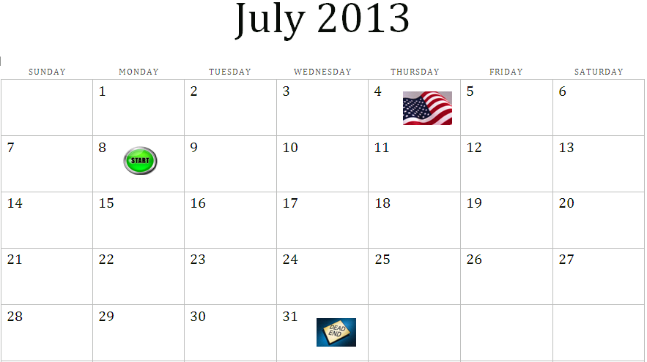
Business Outcomes
MISSION IMPOSSIBLE
Project teams assembled in single location
Less than 20 business days to get 50+ projects past a critical milestone.
All projects needed to have requirements and design complete.
Notes:
BSA’s from April/May work-stream became the trainers with Lead BSA’s to oversee the effort
Our story could have ended here . . . What was at stake? What would have happened had we not done this?
A LOT was riding on these deliverables!

Slide 17
July 2013
Our Response
Brought teams together in a single location (business and IT)
Rolled out the new project methodology (business capability centric requirements) en masse
Delivered training to 200 people (just-in-time)
Created next generation tool kit that enabled portfolio wide resource planning
Leveraged new tools to align subject matter expertise to project needs – near real time
Business Outcomes
MISSION ACCOMPLISHED!

Slide 18

The “calm” after the storm . . .

Slide 19
August and September 2013:
A Multi-Faceted Approach to Organizational Learning
Experiential
“Just in Time” Process Training in Feb, March and July
Established Knowledge Baseline
Organization-Specific
Internal Learning Series: BSA Essential Knowledge
Context for July activities
Foundational academic learning
Proved the methodology works
Notes:
Experiential – what we did in July
Org-specific – GP BAT Learning Series: BSA Essential Knowledge
Professional Development – Business Architecture Certificate Program in partnership with Metro State, Cargill, and General Mills

Slide 20
Organizational Learning Goal
GP BAT Learning Goal
Establish a common language,
Take a consistent approach, and
Apply a repeatable methodology
Enhance learning,
Streamline communications,
Drive efficiency, and
Achieve our goals
Deliver an exemplary experience to our customers and partners.
“Learning is not the accumulation of knowledge, but rather, one thing only: understanding”
- Donna Jo Napoli
“Learning isn't acquiring knowledge so much as it is trimming information that has already been acquired.”
- Criss Jami
Notes:
Donna Jo Napoli (author of children’s and young adult books)
Criss Jami (poet and author)

Slide 21
BSA Essential Knowledge: Results
BSA Essential Knowledge Series
  50 participants completed the 7-session series
 | Pre-Course Survey | Post-Course Survey
I have the information I need to follow the business architecture process (I know what to do and when to do it). | 2.7 | 4.3
I understand my responsibilities and accountabilities as a BSA throughout the project life cycle. | 3.3 | 4.4
Scale of 1-5 (5 = Strongly Agree, 1 = Strongly Disagree)
Business Outcomes
Role and expectations clearly defined
Team IQ increased
Methodology becomes “new normal” within Government Programs
Opportunity to expand to other parts of the enterprise
Canadian subsidiary expresses interest.

Slide 22
August and September 2013:
A Multi-Faceted Approach to Organizational Learning
Experiential
Learning
“Just in Time” Process Training in July
Established Knowledge Baseline
Organization-Specific Learning
Business Architect Certificate
Program
Context for July activities
Foundational academic learning
GP BAT Learning Series: BSA Essential Knowledge
Teamed with Metro State University, Cargill, General Mills and Rust Consulting
12 team members attended BACP Training
Notes:
Experiential – what we did in July
Org-specific – GP BAT Learning Series: BSA Essential Knowledge
Professional Development – Business Architecture Certificate Program in partnership with Metro State, Cargill, and General Mills

Slide 23
2013 --- A Year in Review
Implement Business Capability
Strategy and Approach
Define Strategy and Approach
(April)
Conduct Process “Pilot”
(Call Letter) (May)
Implement
(July)
Train and Build Organizational Knowledge
(Aug-Sept)
Operationalize
(October)
Notes:
July – Implement broadly – large group, large number of projects

Slide 24
VALUE OF BUSINESS ARCHITECTURE
@ Express-Scripts
Business Architecture Value
Consistency
Commitment
Clarity
Notes:
CLARITY (process, role, interactions, scope, vision, make complex challenges easier to understand), CONSISTENCY (process, language, expectations), COMMITMENT (clients, members, shareholders, to each other)
The ultimate goal of any company is to support shareholders and customers . . .

Slide 25

What’s Next? (What we hope to accomplish in 2014)
Taking the approach and tools “enterprise-wide”
Identifying new opportunities for process efficiencies within Business Architecture practice (Business Goal of Reducing Cost to Deliver)
Introducing a governance process for modifying business capabilities (as required)
Assessing the performance/maturity levels of each business capability and comparing to a desired-state
Aligning business capabilities to strategic objectives
Notes:
CLARITY (process, role, interactions, scope, vision, make complex challenges easier to understand), CONSISTENCY (process, language, expectations), COMMITMENT (clients, members, shareholders, to each other)
The ultimate goal of any company is to support shareholders and customers . . .

Slide 26
To Learn More ….
If you are interested in learning more and seeing some of the tools and other artifacts we have created let us know. We would be happy to arrange a conversation.
Notes:
CLARITY (process, role, interactions, scope, vision, make complex challenges easier to understand), CONSISTENCY (process, language, expectations), COMMITMENT (clients, members, shareholders, to each other)
The ultimate goal of any company is to support shareholders and customers . . .

