Slide 1
The Twin Cities Business Architecture Forum Community Update
May 17, 2016

Slide 2
Why we’re here
Charter
Create a Minnesota-based organization dedicated to the understanding and advancement of the role and professional practice of Business Architecture to promote common definition and standards, share ideas, and connect like-minded professionals and networking through meetings, activities, presentations and educational development at the local level.
Mission
The Twin Cities Business Architecture Forum is an association of local Business Architecture professionals dedicated to understanding, documenting and implementing improvements for Business Architecture in all forms. We explore the risks and benefits of key frameworks and standards, learn from and share with each other and support the practice of Business Architecture in the Twin Cities and surrounding area.

Slide 3
TCBAF Year Ahead
Business update
Upcoming events
SIG presentation and next steps
Thrivent presentation

Slide 4
Governance Structure
Name | Representing | Position | Sponsor Representative
Pam Hullander | Cargill | Appointed | Dean Heltemes
Tony Woods | Express Scripts | Appointed | Michelle Wales
Bruce Lindberg | Metro State University | Appointed | Beth Schaefer
Jeff Dreher | Target | Appointed | Tracy Murphy
Jake Laabs | Thrivent | Appointed | Bill Murphy
Pam DeGrote | Trissential | Appointed | Jim Mohs
TBA | Medtronic | Appointed | TBD
Tm Jennissen | Community | Elected | N/A
Sharon Shakya | Community | Elected | N/A
Pat Salaski | Community | Elected | N/A
Linda Finley | Community and Sponsors | Appointed | N/A

Slide 5
2016/17 Programming Schedule
2016/17 Theme – Enabling Strategy to Execution: Explore how your organization can successfully enable strategy execution to the fullest.
Strategy
Portfolio Planning
Execution
Benefits Realization
Strategy to Execution Overview
ExpressScripts (March)
Overview on Strategy to Execution practices – provided by Wynde K
Biz Arch and Agile Transformation
Trissential (July)
What is the intersection of BA and the Agile movement
Leveraging Biz Arch to Ensure Successful Execution
Cargill (November)
Explore how BA can help drive successful execution of key priorities
Measures & Metrics of Success
Express Scripts (March)
Best practices for measuring the success of your BA and Strategy efforts
Strategy Clarification & Alignment
Thrivent (May)
Explore how strategy gets created, clarified and shared across the organization
Capability Assessments in aid of Enterprise Planning
Target (September)
How can Capability Assessments inform enterprise-wide strategy and planning
Biz Arch and Investment Alignment
Metro State (January)
How can BA be leveraged to optimize your investment portfolio
Benefits Realization Aligned to Capability Assessments
Thrivent (May)
How to create business cases and fully realize benefits of investments aligned to capability planning
Notes:
SIG Ideas
-Business / IT Alignment
-Note: May move July meeting to Be The Match & a Twins game
-Note: Target may co-present with Alex Randall in Sept
-Note: Agile speaker first to set the ground; panel discussion 2nd (Garret G from Thrivent)
-2017 Theme: Value Realization

Slide 6
2016 – A Plan forward
January
Metro State
Target’s BAarch Tool Journey
March
Express-Scripts
Strategy to Execution Overview
May
Thrivent
Strategy Creation, Clarification & Alignment
July
Trissential
BArch and Investment Alignment
September
Target
Capability Assessments in aid of Enterprise Planning
November
Cargill
Leveraging BArch to Ensure Successful Execution
1
2
3
4
5
6
7
8
9
10
11
12
February
Board Retreat
Fall
First Annual Business Architecture Community Conference
Key 2016
Plans
Assimilate new Board and Sponsor members
First Annual
Business Architecture Conference
Execute Program Schedule
Grow SIG
Groups
Collegial Collaboration Strategy (i.e.: AEA, DSMBAF)

Slide 7
SIG Overview & Participants
Special Interest Group (SIG) Goals:
Pilot a SIG / working group format for TCBAF (most likely 2-3 meetings on off months)
Ideally a working group of 8 – 12 community members
Share best practices of companies that are currently engaged in capability roadmapping
Examine industry best practices that practitioners may have been exposed to
Create a toolkit or set of observations to bring back to the TCBAF Community in early 2016
Roadmapping SIG Participants
Stephen Clark - Ameriprise Financial
Jeff Dreher – Target
Linda Finley – Leadership Advantage
Webb Friedly – Target
Bob Grogan – Target
Gary Jaax – Optum Health
Tim Jennissen - Blue Cross and Blue Shield of MN
Steve Massine - Target
Pat Salaski – Medtronic
Sharon Shakya – Medica
Notes:
SIG Ideas
-Business / IT Alignment
-Note: May move July meeting to Be The Match & a Twins game
-Note: Target may co-present with Alex Randall in Sept
-Note: Agile speaker first to set the ground; panel discussion 2nd (Garret G from Thrivent)
-2017 Theme: Value Realization

Slide 8
Observations & Lessons Learned
Great opportunity to share real-world ideas and examples
There was a lot of commonality across the group (we’re all facing very similar problems)
Creating a roadmap for the first time is relatively easy, it’s much harder to sustain this effort over time - requires org commitment
Hard to share proprietary information (either requires fuzzing out, or additional work to sanitize information)
Getting a commitment is a challenge; we all live busy lives! Perhaps have an understanding of the commitment going in
Be clear on the start/stop commitment for the SIG
It’s dependent on the members - you get out of it what you put into it
Venue – Kieran’s Irish Pub
Pros: informal environment, good beer, good food, nice networking environment
Con: lack of whiteboard, dimmer lighting, downtown location
Notes:
SIG Ideas
-Business / IT Alignment
-Note: May move July meeting to Be The Match & a Twins game
-Note: Target may co-present with Alex Randall in Sept
-Note: Agile speaker first to set the ground; panel discussion 2nd (Garret G from Thrivent)
-2017 Theme: Value Realization

Slide 9
Context: Enabling Improved Strategy Execution
Enterprise Strategies
Codifying strategy for company-wide consumption
Understand what capabilities will be required to deliver on the strategy
Capabilities Impacted
Capability Gap / Needs Assessment
Understand what gaps / needs are required to realize the strategy
(people, process, tech, data)
Capability Roadmaps
Roadmap how these capability enablers will be delivered over time
Project / Product
Project / Product
Project / Product
App
Arch
Data
Arch
Tech
Arch
Deliver against capability roadmaps
Solution Delivery
Enterprise Arch Planning
Measure the metrics and results to ensure the end-business outcomes were achieved
Results Management
Notes:
Assumptions
Problems that can be solved
Value added
“What is the question that you are trying to answer?”

Slide 10
Problem Statements
No common view of enterprise view of priorities
No common planning vocabulary across the organization
Lack of Business / IT alignment
Cost reduction opportunities (e.g., rationalization/consolidation of systems, organizations or core processes)
Need to rationalizing mergers and acquisitions
Need to support major transformation efforts
No holistic view of people, process, and technology
Notes:
SIG Ideas
-Business / IT Alignment
-Note: May move July meeting to Be The Match & a Twins game
-Note: Target may co-present with Alex Randall in Sept
-Note: Agile speaker first to set the ground; panel discussion 2nd (Garret G from Thrivent)
-2017 Theme: Value Realization

Slide 11
Common Attributes
Attribute | Rationale
Time horizon | Illustrates how the capability evolves over time
What is changing in the capability | Illustrates how capability is transforming from current state to future state
Milestones / outcomes | States major milestones as “what you get” vs. simply project implementation
Constraints | Helps leaders understand what trade-offs may need to be made
Dependencies | Illustrates how different parts of the roadmap connect to each other
Cost/Benefit | Demonstrate time to value, cost of the journey
Maturity of Capability | Illustrates the current state of affairs for leaders
Metrics / KPIs | Demonstrates how progress will be measured over time
Capability Owner | Illustrates who is accountable
Impact to People, Process, Tech, Data | Illustrates the changes that will need to be made to core operations and to technology
Strategic Importance | Illustrates if the capability is a “differentiator” or not for the organization
Trade-Offs, Key Decisions | Illustrates what decisions that sr. leaders may need to make to pave the way for a successful journey
Notes:
SIG Ideas
-Business / IT Alignment
-Note: May move July meeting to Be The Match & a Twins game
-Note: Target may co-present with Alex Randall in Sept
-Note: Agile speaker first to set the ground; panel discussion 2nd (Garret G from Thrivent)
-2017 Theme: Value Realization

Slide 12
Common Use Cases
Capability Point of View
Enterprise Point of View (roll-up of all capability roadmaps)
Application Point of View
Investment Point of View
Cross Capability Initiatives
Merger/Acquisition/Divestiture
Notes:
SIG Ideas
-Business / IT Alignment
-Note: May move July meeting to Be The Match & a Twins game
-Note: Target may co-present with Alex Randall in Sept
-Note: Agile speaker first to set the ground; panel discussion 2nd (Garret G from Thrivent)
-2017 Theme: Value Realization

Slide 13
Future SIGs
What topics would you all like to pursue further as a community?
Examples:
Intersection of Agile & Business Architecture
Breaking down Roadmap Barriers
Others??
Notes:
SIG Ideas
-Business / IT Alignment
-Note: May move July meeting to Be The Match & a Twins game
-Note: Target may co-present with Alex Randall in Sept
-Note: Agile speaker first to set the ground; panel discussion 2nd (Garret G from Thrivent)
-2017 Theme: Value Realization

Slide 14
Examples
Notes:
SIG Ideas
-Business / IT Alignment
-Note: May move July meeting to Be The Match & a Twins game
-Note: Target may co-present with Alex Randall in Sept
-Note: Agile speaker first to set the ground; panel discussion 2nd (Garret G from Thrivent)
-2017 Theme: Value Realization

Slide 15
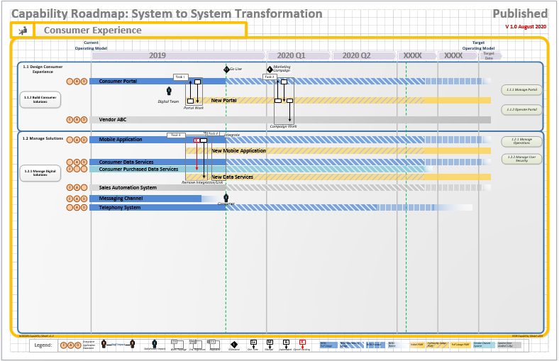
Capability Roadmap Example
Notes:
Roadmap – why was it important for BCBS?

Slide 16
Capability Roadmap Example: What does this Tell Us?
Multiple data points in one view as reference
Input to build the plan of execution
Informs and drives effective communication
Enables active leadership support
Notes:
Now in planning stage which bridges to the execution.
The road map is the link between the innovative ideas (target) and setting the stage for execution.
The road map is capturing multiple data points or concepts including the capture of a work package which is the link between the approach to meet the target and the detailed project planning.
Data points include:
Is the system comprised of Vendor, Application, Datastore?
Are there Staff impacts?
Are there Internal, External stakeholder impacts?
What is the approach to high level task to drive the transformation?
What are key milestones dependent on this transformation, system?
Are there one time, manual, automated or removal of key integrated processes, integrations?
When does a system stop full usage?
Decrease usage?
Runout where no more new work, but items might continue to flow through?
Conversely, what are the patterns for startup on the new systems?
The road map facilitates communication of what we are doing, when we are doing it at a level that anybody can understand with supporting detail below. It is one of the tools to effectively communicate at an aggregate level.
One of the keys for success are active leadership support.

Slide 17
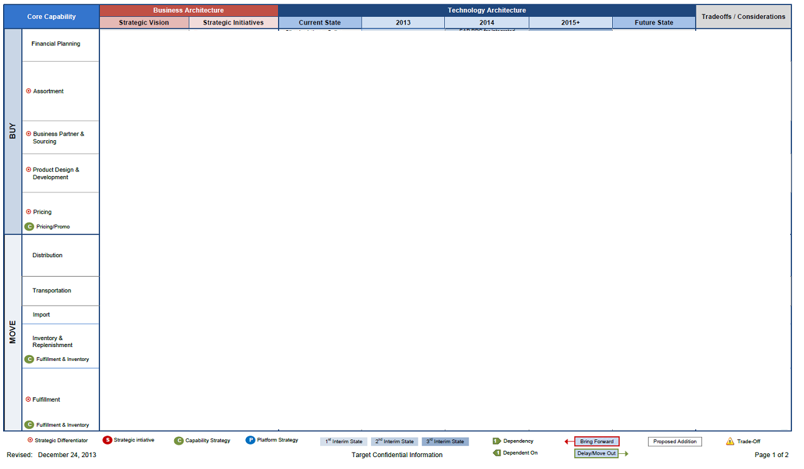
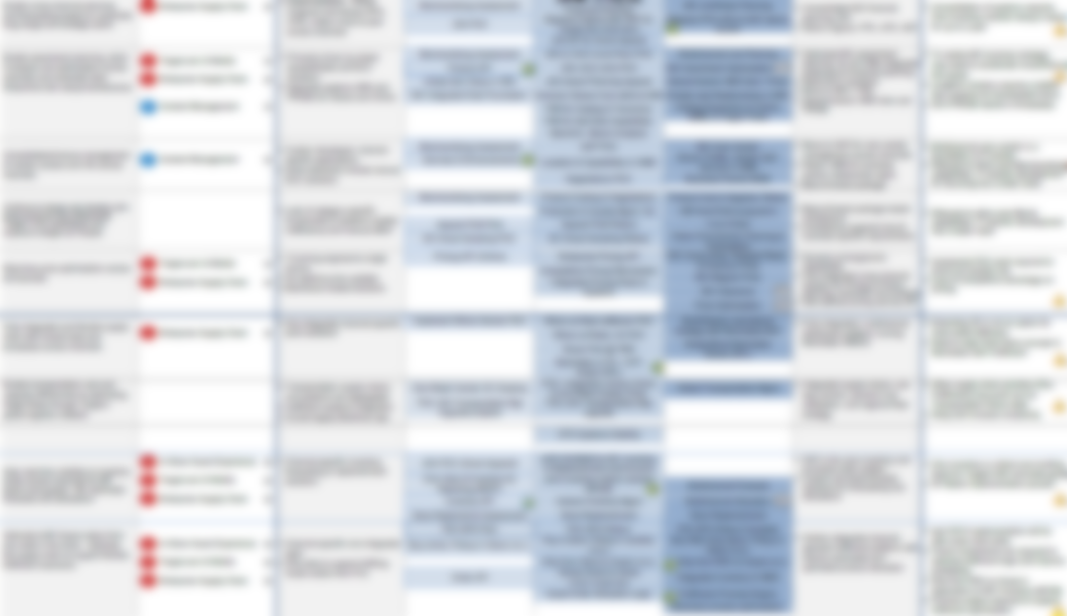
Enterprise POV: Roll-Up of Capability Roadmaps
Notes:
SIG Ideas
-Business / IT Alignment
-Note: May move July meeting to Be The Match & a Twins game
-Note: Target may co-present with Alex Randall in Sept
-Note: Agile speaker first to set the ground; panel discussion 2nd (Garret G from Thrivent)
-2017 Theme: Value Realization

Slide 18
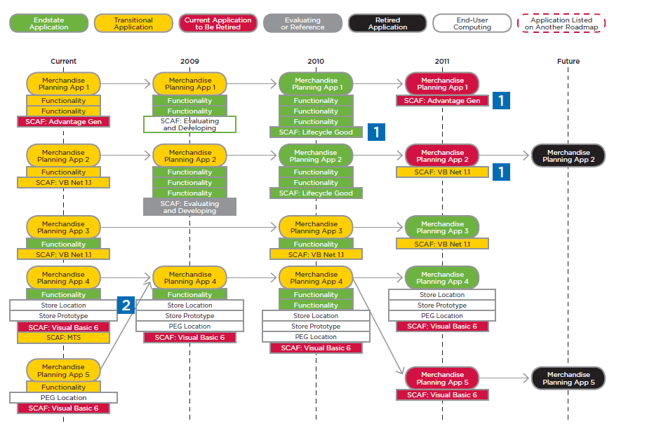
Example: Application Roadmap
Courtesy CEB Roadmapping Guide
Notes:
SIG Ideas
-Business / IT Alignment
-Note: May move July meeting to Be The Match & a Twins game
-Note: Target may co-present with Alex Randall in Sept
-Note: Agile speaker first to set the ground; panel discussion 2nd (Garret G from Thrivent)
-2017 Theme: Value Realization

