Slide 1
Managing SAFe with Business Architecture
Francis S. Fons (Frank),
PMP, CBA (Certified Business Architect), ACP (Agile Certified Practitioner), SAFe Agilist (Scaled Agile Framework Program Leader), Six Sigma Green Belt,
MBA, and BSEE
fons.frank@gmail.com

Slide 2
Agenda
Why care about SAFe?
Organizational Readiness for SAFe
Terminology Challenges with SAFe
Business Architecture Contributions at Portfolio Level
Business Architecture Contributions at Program Level
Business Architecture Contributions at Team Level
Discussion

Slide 3
What is SAFe?
SAFe is an online, freely revealed knowledge base of proven success patterns for implementing Lean-Agile software and systems development at enterprise scale.*
* scaledagileframework.com/about
There are other agile scaling approaches, e.g. Nexus

Slide 4
Why Care about SAFe?
2016 PMI survey published in Pulse of the Profession® results indicated 85% of organizations use agile methodologies
Organizations often struggle when planning releases that involve more than one Agile team.⁽⁸⁾
Scaled Agile Framework (SAFe) developed by well respected agile practitioners
60% of US Fortune 100 companies have SAFe® trained practitioners ⁽⁹⁾
SAFe case studies indicate increases in quality 50%, productivity 20-50%, and delivering more quickly 30-75% of the time ⁽⁹⁾

Slide 5
Traditional Agile versus SAFe ⁽¹¹⁾
Agile
SAFe
Breaks large, monolithic efforts into smaller pieces and enables teams to gather requirements, develop, test, and release in short increments
Builds upon the principles of agile to provide greater alignment, transparency and execution.
Issues:
Resolves Through:
Strategy Misalignment
Overhead Cost / Highly Inefficient
Backlog Paralysis
Layered framework that enables a business to manage, prioritize and organize work more efficiently to meet strategic priorities
Persistent Teams via Agile Release Trains and Value Streams
Notes:
Remove

Slide 6
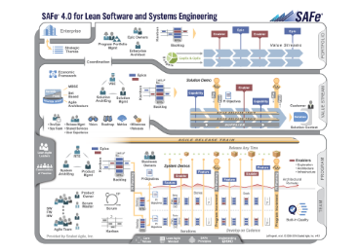
http://www.scaledagileframework.com/

Slide 7
Organizational Readiness
Facilitate clear understanding of vision and strategies
Business Architects facilitate discussions to answer:
Does the organization have the right technology infrastructure, release, and change adoption processes to deploy in a scaled agile framework?
Does the organization have the right skills and commitment from leadership and staff to create value stream themed epics and deliver value?
Do stakeholders understand value streams and their tie to vision and strategy?

Slide 8
Terminology Challenges
Capability is not defined the same in SAFe as it is BIZBOK, but this is reconcilable
Value Streams are broken into Operational and Development Value Streams in SAFe, but BIZBOK Value Streams are close to Operational Value Streams and should be the starting point

Slide 9
Business Architecture Portfolio Contributions
Facilitate strategy discussions to understand enterprise strategy and strategic objectives
Use tools like the business model canvas to illustrate value propositions, channels, customers, etc., and create SAFe strategic themes
Depict value streams for each train program
Use business architecture blueprints to map desired state versus current state

Slide 10
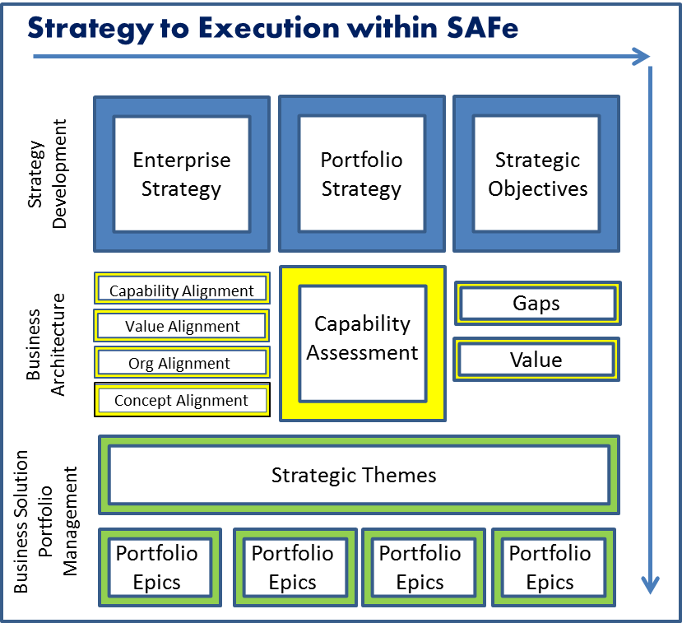
Business Architecture Portfolio Contributions ⁽¹⁰⁾

Slide 11
Future State Business Model Canvas (Current is Black and future includes Red)
Vendor partner with in-app Marketing ad expertise
Application Deployment Planning and Training
Best in market user experience through collaboration features for international sales forces
Co-Creation reward partnerships with Sales professionals
Customer Sales Forces now primary target
Service through device
Service through device
Service through device
Service through device providers
Enhanced investment via technology and Customer survey response analysis
Business Professional mass market
Device distributors
Dedicated help desk for device vendors to support subscribers
Newest technology in mobile business apps
Technology labs
Contracting with device providers
Global and highly mobile work forces
AppStore management and hosting business
High performance and newest business tools
Best help desk
Enhanced distribution and support through AppStores and vendors
Application Trainers
Service through device providers
Best applied technology programmers
Updates to premium users by subscription
Marketing through smart phone dealers
Incentives tied to customer satisfaction
Sales percentages from smartphone distributors
Rewards payments to member Sales professionals
Service through device
Service through device
Fees for technology support to business professionals
Experiment and testing as labor time drivers
Service through device
Research and tech integration as cost drivers

Slide 12
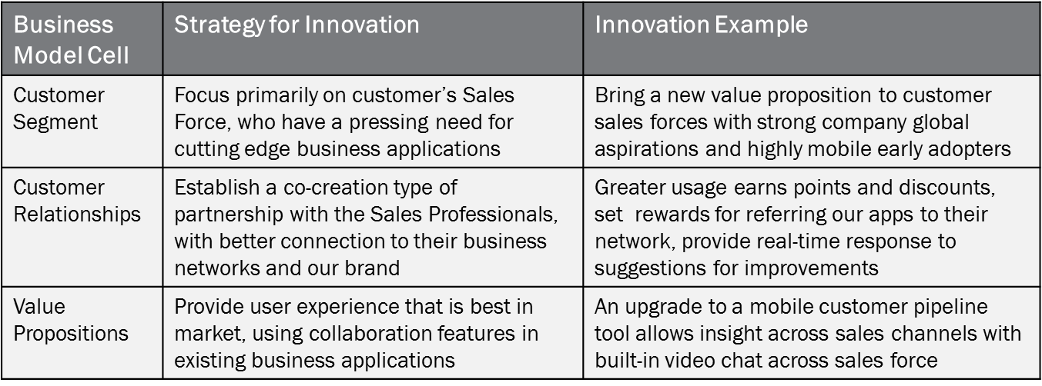
Use of Business Model Canvas

Slide 13
Safe trains and value stream alignment ⁽¹¹⁾
Become Educated
Determine Need
Apply
Obtain Loan
Maintain Loan
Sales Management
Customer Management
Account Management
Customer Management
Customer Management
Marketing
Customer Management
Product/
Customer Matching
Customer Management
Account Management
Account Management
Call Center
Sales Management
Risk
Management
Financial Management
Financial Management
Agency
Accept Req.
Process Fee Pay.
Validate Req.
Apply Change
Notify Applicant
Billing
Customer Management
Product/
Customer Matching
Risk
Management
Account Management
Account Management
Underwriting
Financial Management
Customer Management
Notes:
Remove

Slide 14
Business Architecture Portfolio Contributions (continued)
Facilitate discussions to understand and document capability maturity needed for strategies needed to achieve desired innovation
Facilitate discussions to create epics
Help prioritize portfolio backlog

Slide 15
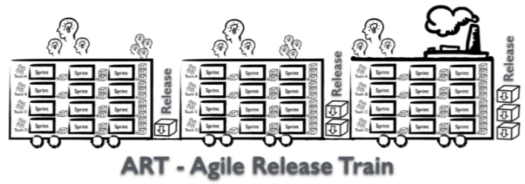
Start with the blueprint ⁽¹¹⁾
Example: Home Loans by EZ$
Become Educated
Determine Need
Apply
Obtain Loan
Maintain Loan
Sales Management
Customer Management
Account Management
Customer Management
Customer Management
Customer Management
Product/
Customer Matching
Customer Management
Account Management
Account Management
Sales Management
Risk
Management
Financial Management
Financial Management

Slide 16
Apply heat ⁽¹¹⁾
Become Educated
Determine Need
Apply
Obtain Loan
Maintain Loan
Sales Management
Customer Management
Account Management
Customer Management
Customer Management
Customer Management
Product/
Customer Matching
Customer Management
Account Management
Account Management
Sales Management
Risk
Management
Financial Management
Financial Management
Where do you have gaps that align to strategy?
What will preclude you from achieving strategic objectives?
Where do you want to hold a position of differentiation in the marketplace?
Notes:
Remove

Slide 17
Identify root causes (gaps) ⁽¹¹⁾
Account Management
Account Structure Management
Basic Eligibility
Account Price Determination
Capability Alignment to Information, Processes and Organization
Notification Management
Customer Notifications
Customer Preferences
Stakeholder Notifications
Payment Management
Billing Management
Collection Management
Status Management
Where does the heat come from? Gaps in the way we manage the customer risk score between our underwriters and agents.
Escrow Management
Tax Adjustment
Insurance Holdings
PMI Management
Notes:
Remove

Slide 18
Create themes and epics ⁽¹¹⁾
Strategic Theme
Replace Loan Administration System
Billing Management
Customer Notifications
Portfolio Epics
Account Structure Management
Escrow Management
Program Epics
Create Pricing Dashboard
Electronic Statements
Online Payment
Text/SMS Notifications
Review Journey map
Statement Type Selection
Bank Integration
Provider Considerations
Features
Design UI
Design UI
Payment Type Determination
Messaging
Infrastructure
Annual Payments
Design UI
Links
Notes:
Remove

Slide 19
Business Architecture Portfolio Contributions (continued)
Create role relationship diagrams for each epic
Uncover epic dependencies on other areas
Facilitate metric development with business architecture deliverables
Participate in epic handoff discussions

Slide 20
Sample Role Relationship Diagram ⁽¹²⁾

Slide 21
Business Architecture Program Level Contributions
Consistently use scenario discussions and expected value tied to value streams and desired capability maturity
Assist with roadmap development tied to minimal viable product for each release
Help identify and prioritize features with WSJF
Contribute to definition of done

Slide 22
Business Architecture Program Level Contributions
Provide framework for traceability for showcases and program increment planning
Collaborate with IT Architecture to drive out runway of available features for teams to pull

Slide 23
Business Architecture Frame of Reference Enables Business Requirements Traceability across Multiple Business Perspectives
Alex Randell, Eric Spellman, William Ulrich, Jeffrey Walk. “Leveraging Business Architecture to Improve Business Requirements Analysis – A Business Architecture Guild White Paper,” Mar. 2014.

Slide 24
Business Architecture Team Level Contributions
Provide clear explanation of strategy, vision, roadmap, and dependencies, tied to value streams and capability maturity for each feature
Participate in feature handoff discussions
Participate in sprint demos and program increment showcases

Slide 25
Key Learnings ⁽¹¹⁾
Overall
Value Streams can provide the business blueprint that guides the alignment of an Agile Release Train (ART) to strategic work and assist in identifying interdependencies among ART’s
Understanding business gaps, perceived value and priority is critical
The transparency and sharing across the entire SAFe Train is critical in making empowered decisions from portfolio all the way down through scrum teams

Slide 26
Discussion Thank You Frank Fons, Senior Business Architect at HCSC fons.frank@gmail.com or francis_s_fons@bcbsil.com Francis Fons on LinkedIn

Slide 27
Appendix: Definition and Use of Business Architecture
Business Architecture: “A blueprint of the enterprise that provides a common understanding of the organization and is used to align strategic objectives and tactical demands.”⁽⁴⁾
Deliverables provide
Communication Tools for Stakeholders
Basis for Epics, Features, Stories, Requirements Definition
Basis for Metrics

Slide 28
Appendix: Some Key Elements of Scaled Agile Framework (SAFe) http://www.scaledagileframework.com/
Establish Portfolio Management Team(s), Program Management Team(s), and Dedicated Development Teams, empowering decentralized decision-making
Early collaboration of business and IT architecture to build “runway”
Use the concept of a Release Train with no more than 150 people on each train. Fund Release Trains versus individual projects or programs.
Program Increments are typically composed of 5 2-week sprints capped off with showcase.

Slide 29
Some Key Elements of Scaled Agile Framework (SAFe) http://www.scaledagileframework.com/
Use program scrum of scrums to manage different teams on each release train and portfolio scrum of scrums to manage different release trains in a business division, and division scrum of scrums to manage different portfolios across the enterprise.
Limit queue size to maximize productivity
Pull down work versus push down work from portfolio to program to teams
Definition of done for each stage is critical
Epics at portfolio, Features at program, Stories at team

Slide 30
Appendix: “Agile Methodology” versus Lean versus Six Sigma
Agile advocates iterative elaboration to be lean
Originally applied to software development
Adapted throughout business
Agile is a journey to becoming flexible and quick ⁽²⁾ with emphasis on delivering value in a rapidly evolving environment
Six Sigma is statistical technique to achieve lean
Agile Manifesto Values | Over
Individuals | Processes and Tools
Working Software | Comprehensive Documentation
Customer Collaboration | Contract Negotiation
Rapid Responses to Change | Adherence to Rigid Plans

Slide 31
Appendix: Overcoming risks of Agile methodologies
Risk with Agile | Mitigation
Missing two key components - budgeting and sophisticated scheduling | The PMBOK® Guide solves those problems and makes Agile better! ⁽¹⁾
Independent teams set their own priorities | Scaled Agile Framework (SAFe) addresses several challenges of self-directed scrum teams
Dependencies and coordinated value delivery problematic | Engage program/portfolio managers to coordinate dependencies across scrums and use demos and showcases
Lack of formal communication to and from self-directed teams may result in waste and/or missed value | Before every sprint or program increment, PM’s/Scrum Masters/Release Train Engineers consult with product managers and business and IT architects to review any changes in strategy and impact on feature backlog

Slide 32
Integrating Business Architecture into Agile methodologies
Best practice suggests the following cycle:
Facilitate Brainstorming about Mission and Vision
Conduct customer and stakeholder research
(p. 8 of Business Architecture and Agile Methodologies whitepaper by Eric Shane Elliot, Francis Fons, Alex Randell) Key questions to ask include:
• Who are the key stakeholders?
• What pain points are felt by customers?
• What pain points are felt by the executives?
• What are the immediate business priorities?
• What are the pending initiatives and their prioritization?
3. Formulate goals and strategies

Slide 33
Integrating Business Architecture into Agile methodologies (continued)
Review capability maturity (Assumes organization mapped capabilities already) and utilize performance dashboard and analysis tools like Porter’s Five Forces model⁽⁵⁾, the Business Model Canvas⁽⁶⁾, SWOT Analysis⁽⁷⁾ and/or Impact Grid ⁽³⁾
Prepare Business Architecture deliverables focused on goals and strategies and business model canvases
Strategy maps
Capability heat maps
Value streams
Process maps, context diagrams, role relationship diagrams, and information maps, desired versus current state

Slide 34
Appendix: Value Stream and Capability Heat Map Simple Examples
Place Order
Prepare Coffee
Collect Payment
Deliver Cup of Coffee
Financial Management | Human Resource Management | Marketing Management
Customer Management | Production Management | Product Management

Slide 35
Integrating Business Architecture into Agile methodologies (continued)
Business Architects collaborate with Agile portfolio and program management teams on Epic, Feature, and Backlog prioritization
Use end to end scenarios, context diagrams, and value streams to frame desired outcomes for relevant stakeholders
Use WSJF or like concept for backlog prioritization -> Cost of Delay/Job Size, ranking highest to lowest
Facilitate discussions around base values for business value, time criticality, risk reduction/opportunity enablement, and job size

Slide 36
Resources 1) John Stenbeck, PMP, PMI-ACP, CSM, CSP of GR8PM 2) ASPE – PMI Agile Certified Practitioner Workshop Materials in conjuction with Davisbase, now part of Solutions IQ 3) Impact Grid is part of methodology developed and employed by SentientPoint principal partners Jack Hilty and Janice Koerber 4) Business Architecture Guild, A Guide to the Business Architecture Body of Knowledge™, v 5.1 (BIZBOK® Guide), 2016. Part 1, Page 1.

Slide 37
Resources 5 ) "Porter Five Forces Analysis." Wikipedia. Wikimedia Foundation, Mar. 2014. Web. Nov. 2014. 6) Business Model Generation, A. Osterwalder, Yves Pigneur et al., self-published, 2010. 7) Business Architecture Guild, A Guide to the Business Architecture Body of Knowledge™, v 5.1 (BIZBOK® Guide), 2014. Section 2.1, Pages 27-28. 8) “5 Reasons to Consider (SAFe®®)” Josh Fruit Solutions IQ Blog Post from January 28, 2016 9) Dean Leffingwell, in a January 31, 2016 post to the www.scaledagileframework.com

Slide 38
Resources 10) Renee Batts, Senior Business Architect at Principal 11) Sebastian Escobar, Senior Business Architect at STA Group and Renee Batts, from their webinar presentation in 2016 to the Business Architecture Guild about SAFe and Business Architecture 12) Role Relationship Concept Developed by Sebastian Escobar with assistance from Solutions IQ and used by Frank Fons

Slide 39
Resources 13) Why Agile Initiatives Fail and Why DevOps Initiatives Should Worry July 17, 2013 By Mike Kavis (Mike Kavis on Google+) 14) Blending Traditional and Agile Project Documentation A project Portfolio Perspective, Fergal McGovern, Founder, VisibleThread 15) “Business Architecture and Agile Methodologies”, A Business Architecture Guild Whitepaper, February 2015, Eric Shayne Elliott, Francis Fons, Alex Randell

