Slide 1
Creating a Business Architecture Practice
Charleston Thomas / Kristin Schroeder
TCBAF Summit
December 1, 2016

Slide 2
Agenda
Introductions
About Mayo
A Tale of Two Practices
Lessons Learned / Critical Success Factors
Q & A

Slide 3
Mayo Clinic
A flyover….
3 major campuses + MCHS
Approximately 60,000 employees
Ranked no. 1 “best hospital” by US News & World Report for 2016-2017
  Ranked no. 1 in 8 specialties
Primary value: the needs of the patient come first
3 shields: clinical practice, research, and education

Slide 4


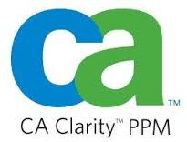
3 Major Investments
Mayo Clinic made 3 major investments which allowed Business Architecture to grow roots and mature
Enterprise
Architecture
Team
Enterprise
Architecture
Platform
Consolidated Portfolio Mgmt

Slide 5
Strategic Imperative
Detailed Description
3-5
Success Criteria
3-5
Pain Points/ Obstacles
Process Implications
Technology Implication
Organizational
Implications
Platforms
Biz Areas

Slide 6
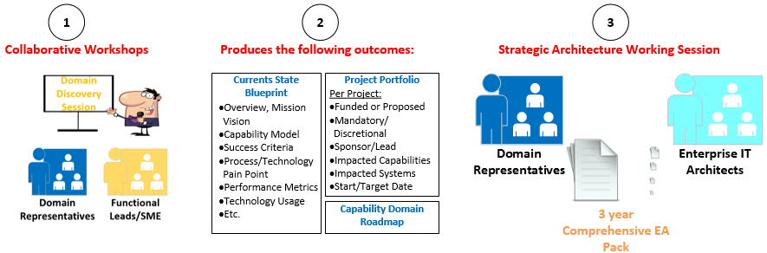

3 Step Process
Notes:
Questions: I hired you to build a business architecture practice we can use as tool to solve business problems. Help me understand how you are going about accomplishing that.
3 steps process that starts with learning and discovery work.
Collaborative discussion with various SMEs and Functional leads to capture what we collectively know about the domain
Document the outcomes
Use these outcomes to drive EA discussion and build a multi-year EA Packet for review

Slide 7
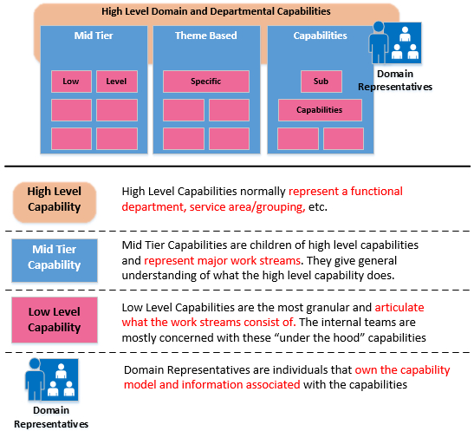
Capability Domain Components
1
2
3
These are typically business representatives
Notes:
Question: Can you tell me more about capability domains and ...

Slide 8
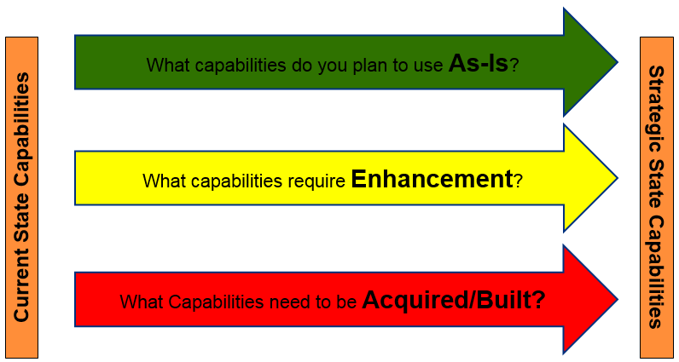
Heat Map Legend
The Future
Today
The goal is, over time, we invest in efforts that convert the Red and Yellow capabilities to a Green state
Notes:
how they are used to set clear expectation with business and IT leaders?

Slide 9
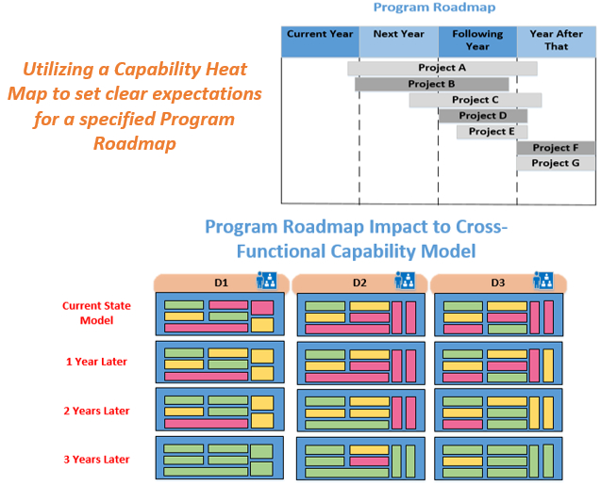
Cross Domain Program Roadmapping
Notes:
how they are used to set clear expectation with business and IT leaders

Slide 10
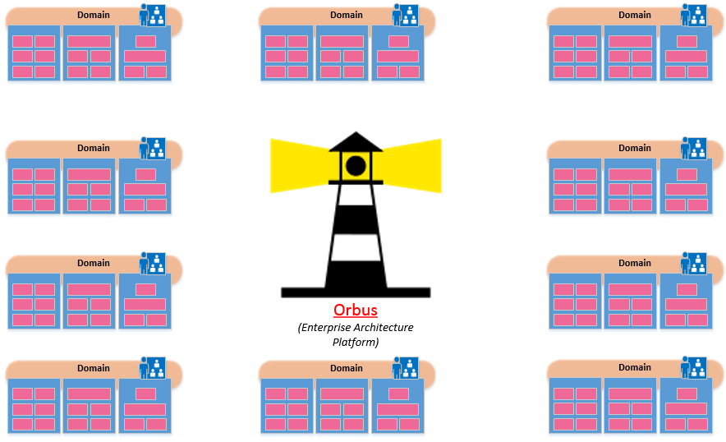
Benefits of Orbus (EA Platform)
Orbus allows the Mayo community to shine a light on the strategic direction/implications of the company and/or specified domains.

Slide 11
Why Business Architecture?
Coordinated and collaborative visioning sessions focused on a specific business area
Capability-based approach to strategic planning that addresses the competence required to execute on your vision
Increased alignment amongst Biz and IT leadership which ensures expected outcomes are clear
Comprehensive EA reviews that covers grouping of projects and reduces time invested in getting efforts approved
Notes:
Just to summarize…Can you tell the audience the benefit of leading strategic planning efforts with business architecture?

Slide 12
Business Architecture:
Segment Level

Slide 13
DLMP
Department of Laboratory Medicine and Pathology
~ 3,500 employees
> 60 laboratories (MN, FL, AZ)
Mayo Medical Laboratories (reference lab)
  Global presence
  For-profit

Slide 14
DLMP: Our Journey
Portfolio Process Improvement Initiative
-Creation of Arch Board
-Biz Arch Role
-Alignment with EA
-Fully allocated resources
-Pre-planning value-add
- Draft Capability Model
-Socialize the message
-Blueprint Phase 1
-Restart
-Checkpoints
-Build network
-Resource add approval
2016
2015
2014

Slide 15



More about Pre-Planning
Initial
Value
Score
Portfolio Planning
Effort Delivery
Ongoing
Architectural Fit – Scoping - Approach
Business Case – Detail Planning
Develop - Test - Implement
Preliminary strategic and technical assessment, business and financial assessment
“What?”
“Why?”
“Can we?”
“Should we?”
“When?”
Detailed technical assessment, concept testing, develop the product definition and project plan.
Process Flow
Intake
Initial Screen/ Value Score
Pre- Planning
Initiate
Plan
Execute
Close
Maintain & Support
1
2
3
4
5
Administrator Approval
L1
L2
SPAD
L3
F
Prioritization
&
Initiate
Approval to Execute
Governance / Checkpoints
Approval to Investigate
Approval to Plan
Approval to Implement
QA Meeting
L
F
Future LBTA Checkpoint
IMPT Governance Gate
LBTA Checkpoint
Administration Approval / Hard Stop
IMPT = Information Management Portfolio Team
5/23/16
LBTA = Lab Business & Technical Architecture
SPAD= Security, Privacy, Architecture, Data Assurance

Slide 16
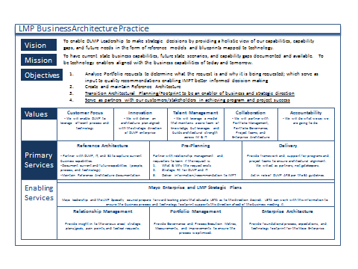
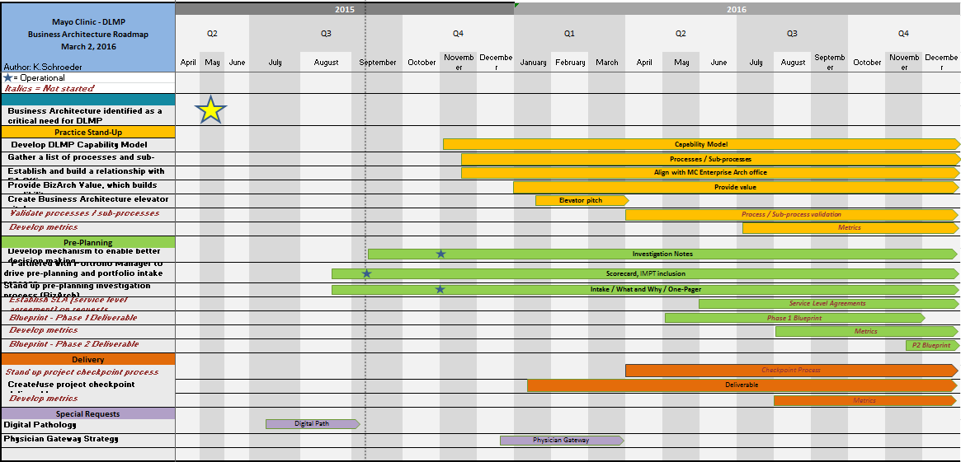
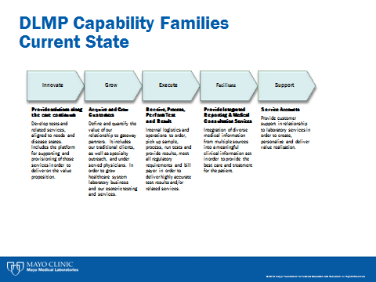
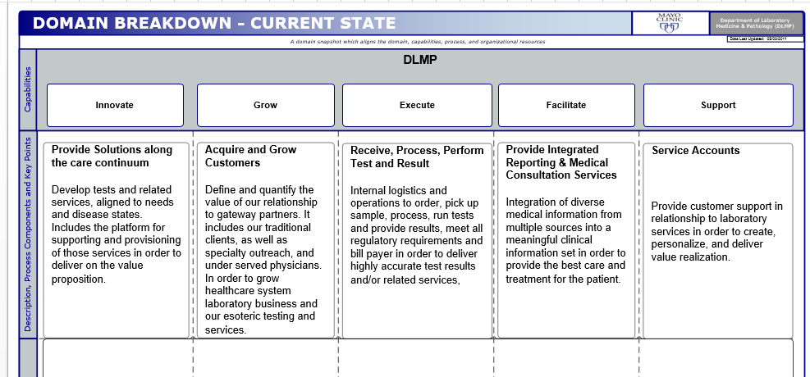
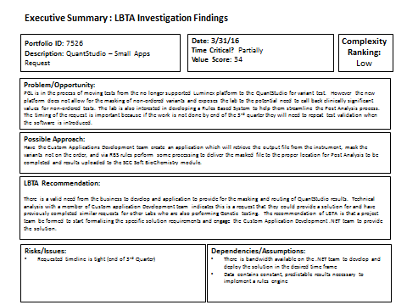
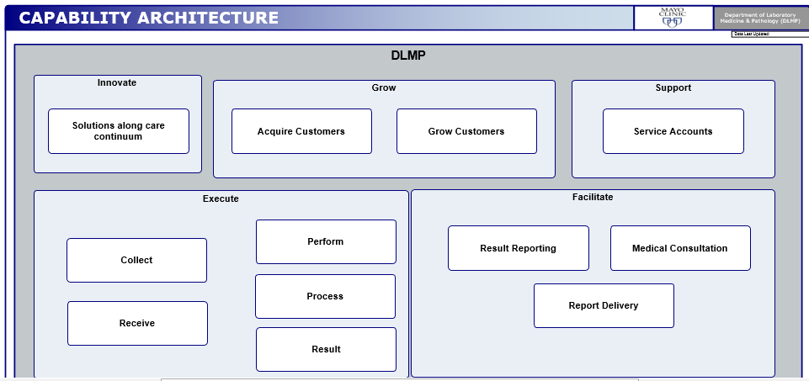
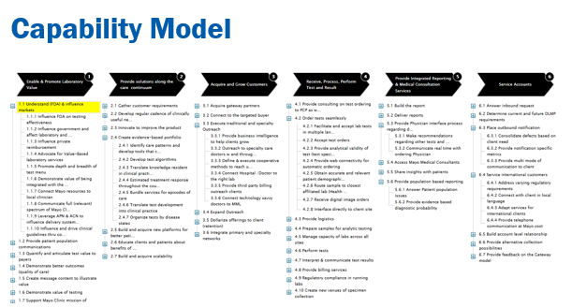
Sample Deliverables
ROADMAP
GLOSSY
BLUEPRINT
CAPABILITY MODEL
INVESTIGATION NOTES SUMMARY
Notes:
Biz Arch – one of the principles is that it isn’t about the deliverables – remember that. I’m including them for reference.
Roadmap: Key for the new leadership (“what have you done” story).
Glossy: A way to communicate with our stakeholders.
Trouble with the BA group (why can’t we do what you’re doing on the pre-planning stuff)

Slide 17
Lessons Learned / Critical Success Factors
Executive sponsor / leadership support
Solid rapport / relationships with key leaders
EA Platform / Strategic Architecture Repository
Stay engaged with Portfolio Mgmt
Provide value early / choose a place to be strategic
Build an industry network; leverage the learnings
Socialize the message, and keep it simple
Think big, start small, move fast

Slide 18
On the Horizon
Increase adoption
Apply to the practice
Book of Business Roadmapping
Enforced Architectural Standards
Partnership with CX – How do we work together?
Capability Assessments

Slide 19

Questions & Discussion

