Slide 1
Linking Business Architecture and Business Analysis
TCBAF Summit
December 1, 2016
Presenter: Mary Auer

Slide 2
I see connections…
Portfolio Management
Business Analysis
Change Management
Project Management
Stakeholder Requirements
Requirements
Stakeholder Management
Business Requirements
System Changes
Application Architecture
Data Management
Process Architecture
Technical Architecture
Data Architecture
Solution Architecture
Process Modeling
Application
Process
Data
Enterprise Architecture
People
Security Architecture
Capabilities
Business Architecture

Slide 3
I see connections…
Business Analysis
Stakeholder Management
Process Modeling
System Changes
Data Management
Capabilities
Business Architecture

Slide 4
Why make the connection….Challenges
Business Architects
Keeping view of enablers up to date
Common language across the organization
Business Analysis
Identifying all relevant stakeholders
Understand the purpose and why
Traceability from Strategy to Requirements
Not understanding journey to project

Slide 5
Objective
Start the conversation about how to share information between Business Architects and Business Analysts so both teams can do a better job faster.

Slide 6
Information to share…
Business Architecture
Visibility to capabilities that directly impact strategy
Enablers that support the capabilities
Pain points captured during Capability Assessments
Business Analyst
Changes that impact enablers
Success Criteria

Slide 7
Making the Connection
People (Organization)
Business Analysis
Technology (Application)
Business Capability
Process
Information (Data)

Slide 8
Key Artifacts to Enable Communication
Business Architecture Artifacts
Capability Enablers Maps
Value Stream Map
Strategy to Capability Map
Capability Gap Assessment
Project and Business Analyst Artifacts
Project Charter and Business Case
Business Process Model

Slide 9
Capability to Enablers Map
Capability | People | Process | Data | Tools
Financial Management | CFO Controller Accountants | Prepare financial report Prepare annual report | Chart of Accounts GL Balances | ERP Tax Software Analytics tool
IT Management | CIO IT Team End users | Resolve Production Incident Implement Software Change | System up time Number of defects | MS Project Service Now
Biz Arch

Slide 10
Value Stream Map
Marketing Management
Order Management
Manufacturing
Transportation and Logistics
Visibility to upstream and downstream capabilities helps identify upstream and downstream stakeholders and processes
Biz Arch

Slide 11
Strategy to Capability Map
Strategy
Action 1
Action 2
Outcome 1
Outcome 2
Outcome 3
Capability A
Capability B
Capability C
Biz Arch

Slide 12
Capability Gap Assessment
When performing the Gap assessment details about the enables are captured:
Who are the people being taken into account, key stakeholders, impacted teams
What processes have the opportunities for improvement or are impacted by the other gaps identified
What data objects are missing or not easily accessible
Which systems are underperforming, exist in the environment and could be expanded to fill the gaps
Business Strategy | Capability 1
People | Current | Future
Gap Statement
Process | Current | Future
Gap Statement
Information | Current | Future
Gap Statement
Technology | Current | Future
Gap Statement
Biz Arch

Slide 13
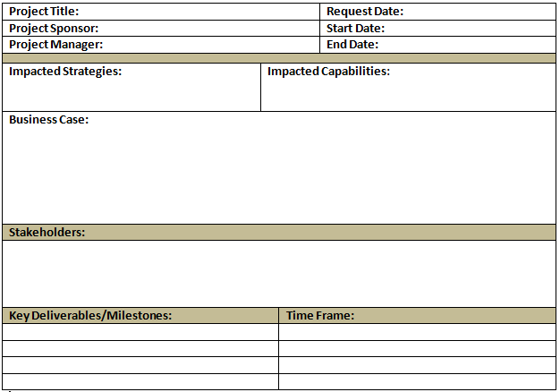
Project Charter and Business Case
Update project charter to ask for Impacted Strategy and Impacted Capabilities on all projects.
Roadmap projects pull details for business case from the Business Capability Gap Assessment.
Stakeholders identified based on Capability Enablers and Gap Assessment.
Biz Arch
Biz Anlys

Slide 14
Business Process Model
SAP
Technology / System
Capture Order
Customer Service
People
Customer
Information / Data
SAP
Material
Review Order
Service Advisor
Customer
Material
Confirm Pricing
Approve Order
Biz Anlys

Slide 15
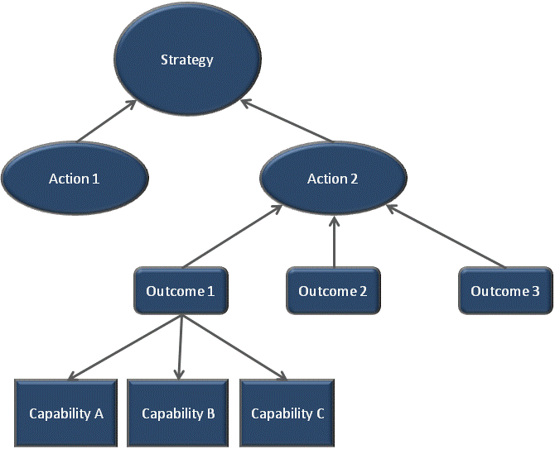
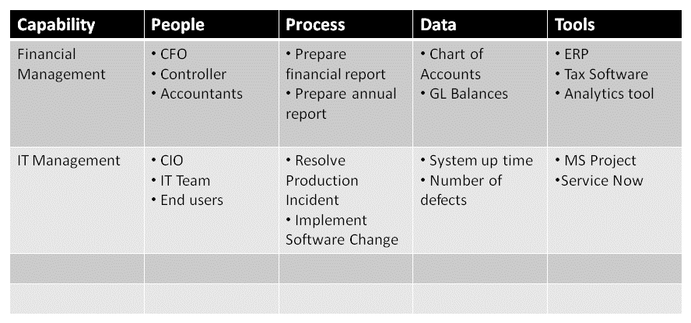
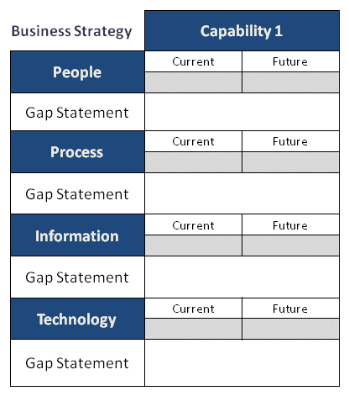
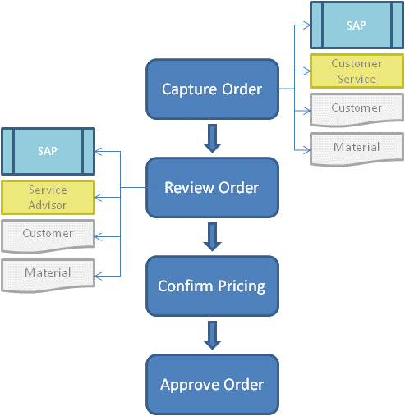
Communication Cycle

Slide 16
Take-a-Ways: Keys to Communication
Educate Business Analyst on Business Architecture
Drive common language
Develop ongoing partnership with Business Analyst team
Include Business Analysts
Look for other connections
Requirements Traceability Matrix
Data Flow Diagrams
SIPOC
Use Cases
...etc.

Slide 17
Contact Information
Mary Waters, MBA
Independent Consultant at Concord USA
marywatersauer@gmail.com
Jenny Scott, CBAP
Principle IT Business Analyst at Hennepin County
jenny@tnjscott.com

